Slide 1
WEB 322 WEB PROGRAMMING TOOLS AND FRAMEWORKS
Week 7 – Lecture 1
AJAX

Slide 2

What is AJAX?
Not the City in Ontario.
Not the Football Club in Amsterdam.
Not the household cleaner.
It stands for:
Asynchronous JavaScript and XML
Enables data to be transferred between a web client and server without the need to refresh the page.

Slide 3
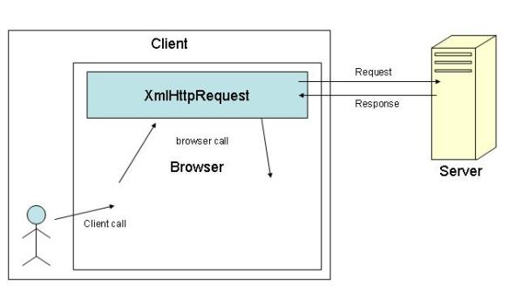
Older Browser Support (XMLHttpRequest)
XMLHttpRequest (XHR) objects are used to interact with servers.
Retrieve data from a URL without having to refresh the page.
Update a portion of the page without disrupting the user.
Can be used to retrieve any type of data, not just XML.

Slide 4
Fetch API
Supports a modern “Fetch API”.
A generic interface that can be used for more than network requests.
Uses Request and Response objects, plus more.
Promise-based data retrieval.
fetch (url, options)

Slide 5
Creating a request
The location of the resource
For example, a URI: https://fetch.com/from/
A set of “options”, defined as a JavaScript object literal, may include:
The HTTP method (GET, POST, etc)
The HTTP headers
The ‘body’ of the request
var myRequest = new Request('https://reqres.in/api/users/’, {
method: 'POST’,
body: JSON.stringify({user:"John Doe", job:"unknown"}),
headers: { 'Content-Type': 'application/json’ }
});

Slide 6
Fetching Data
Pass your request to the fetch() method.
fetch() will return a Promise.
A promise is a guarantee that an asynchronous action will “do something”.
There are three states
Pending: still waiting for the task to finish
Resolved: the task has completed
Rejected: the task has failed
A fetch() will always resolve some Response, whether it is successful or not.

Slide 7
Receiving a Response
Was it successful?
status to check the HTTP status code
ok to see if it was successful
text() method can be used to read the response stream as text.
json() method can be used to read the response stream as an object.
fetch(myRequest).then(function(response) {
return response.json();
}).then(function(json) {
console.log(json); // here is the parsed JSON response
});

Slide 8
Compressed Syntax
fetch('https://reqres.in/api/users/’, {
method: 'POST’,
body: JSON.stringify({user:"John Doe", job:"unknown"}),
headers: { 'Content-Type': 'application/json’}
})
.then(response => response.json())
.then(json => {
console.log(json);
});

Slide 9

JSON
JavaScript Object Notation
Plain-text format that easily converts to a JavaScript object.
A way define objects using “Object Literals”, outside of JavaScript.
Format of choice when sending data to/from a web server.
Convert to/from JavaScript objects using the JSON object.

Slide 10
Conversion Using JSON
let myJSONStr = '{"users":[
{"userId":1,"fName":"Joe","lName":"Smith"},
{"userId":2,"fName":"Jeffrey","lName":"Sherman"},
{"userId":3,"fName":"Shantell","lName":"McLeod"}]} ‘;
// Convert to an object
let myObj = JSON.parse(myJSONStr);
// Access the 3rd user (Shantell McLeod)
console.log(myObj.users[2].fName); // Shantell
let myObj = { users: [
{userId:1,fName:"Joe",lName:"Smith"},
{userId:2,fName:"Jeffrey",lName:"Sherman"},
{userId:3,fName:"Shantell",lName:"McLeod"}]};
// Convert to a string
let myJSON = JSON.stringify(myObj);
console.log(myJSON);
// Outputs: '{"users":[{"userId":1,"fName":"Joe","lName":"Smith"},{ …

Slide 11

RESTful API
Representational State Transfer API.
Uses the HTTP Protocol with a JSON or XMl body.
Requests can be made from any device/platform:
Web browser, mobile device, desktop application.
Standardized messaging.
Can be used to perform CRUD operations on data:
GET: find/select an entity
POST: add a new entity
PUT: update an entity
DELETE: delete an entity
app.get("/api/users", (req, res) => { … })
app.get("/api/users/:userId", (req, res) => { … req.params.userId });
app.post("/api/users", (req, res) => { … });
app.put("/api/users/:userId", (req, res) => { … req.params.userId});
app.delete("/api/users/:userId", (req, res) => { … req.params.userId });

Slide 12
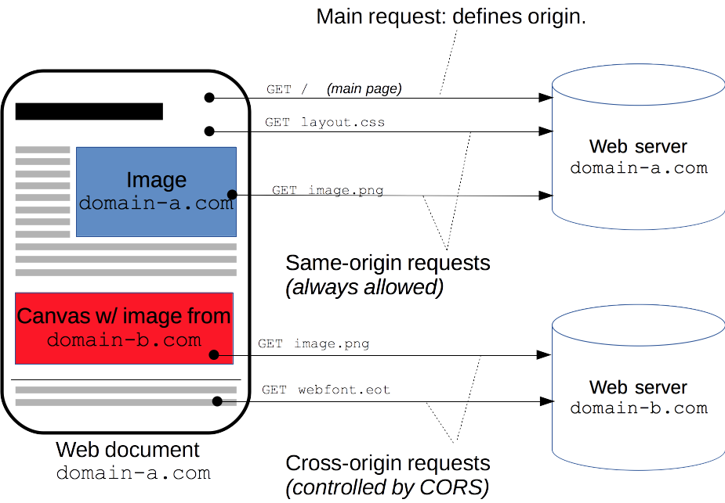
CORS
Cross-Origin Resource Sharing.
Same-Origin Policy:
Default browser behaviour.
Restrict script-initiated requests made from outside the domain.
HTTP-header to allow cross-site requests:
Access-Control-Allow-Origin
Lists the domains where requests can be made from.
Do not include the domain of your server.

Slide 13

Live Demo
Simple Express App to answer AJAX Requests

